Slide 1

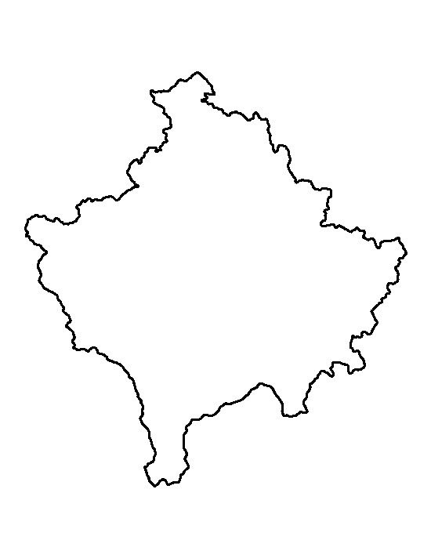
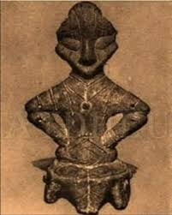

KOSOVO
From Ancient time to Today

Slide 2
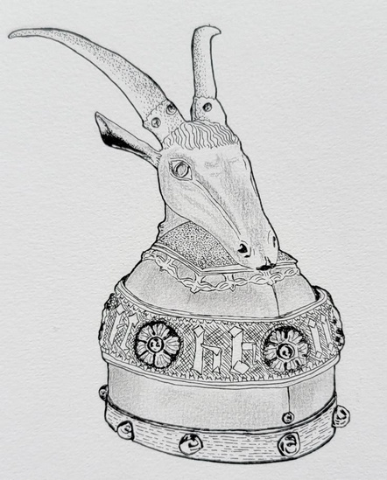
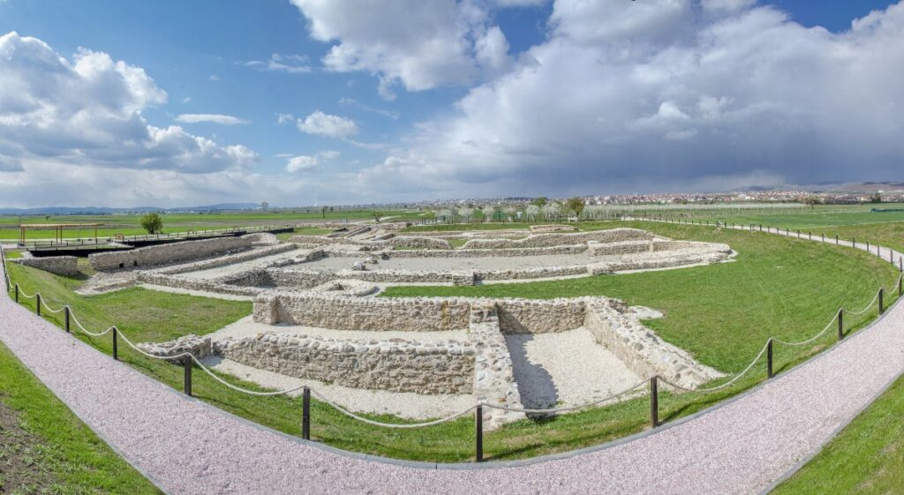

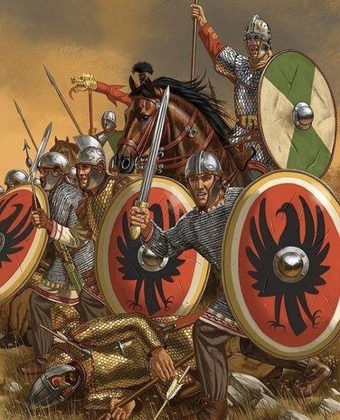

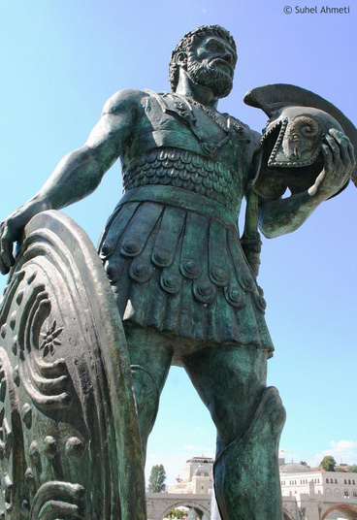
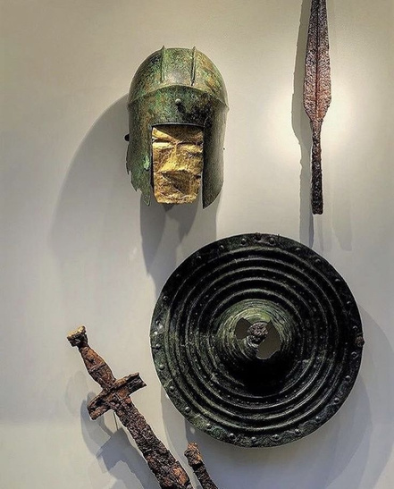
ANCIENT ROOTS (THE KINGDOM OF DARDANIA)
Ulpiana: Located near Prishtina, this was a major Dardanian and later Roman city. It is one of the most important archaeological sites in the Balkans.
  The People: Modern-day Kosovo was the heart of the Dardanian Kingdom, one of the most powerful Illyrian tribes.
  The Name: Derived from the Illyrian/Albanian word "Dardhë" (Pear), signifying a land of fertility and agriculture.
  Reputation: Ancient Greek and Roman historians described them as powerful warriors and skilled miners.

Slide 3
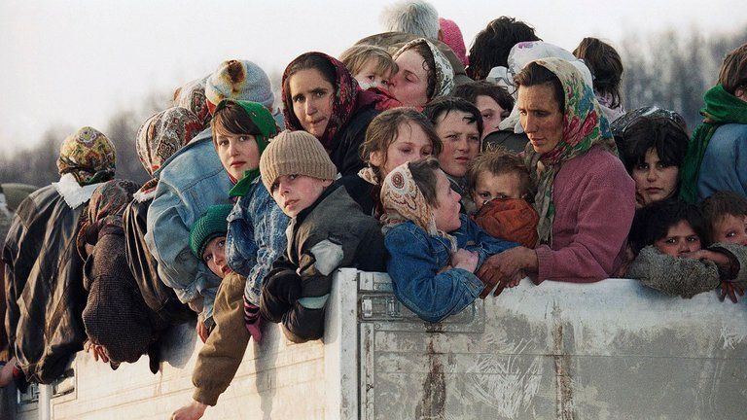
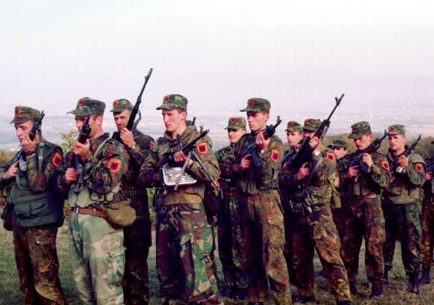
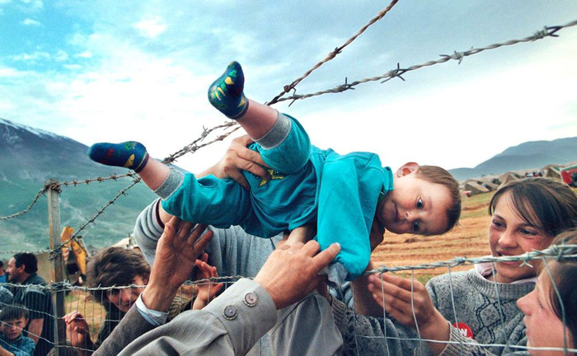
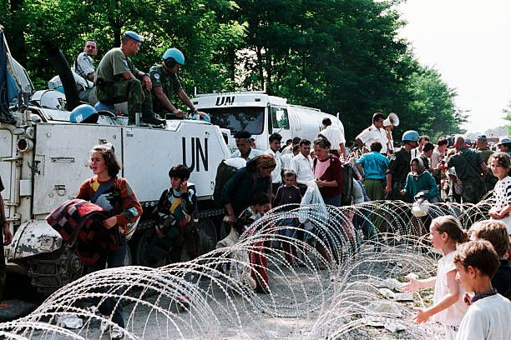
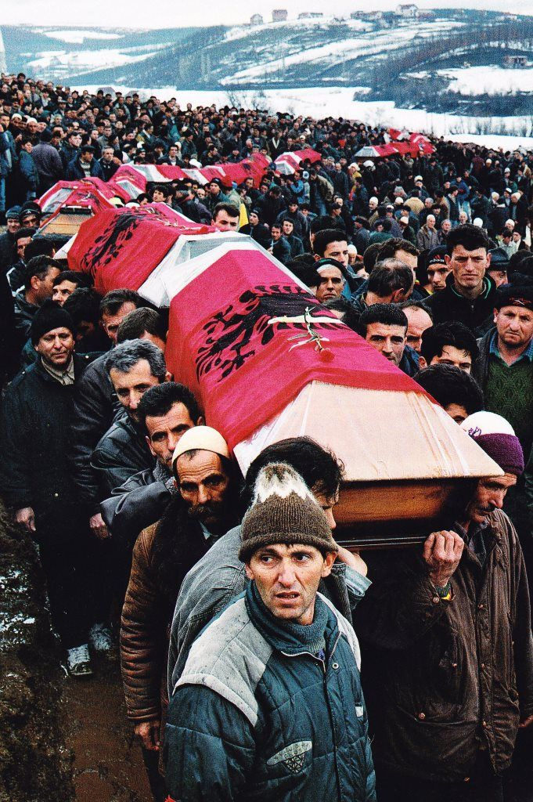
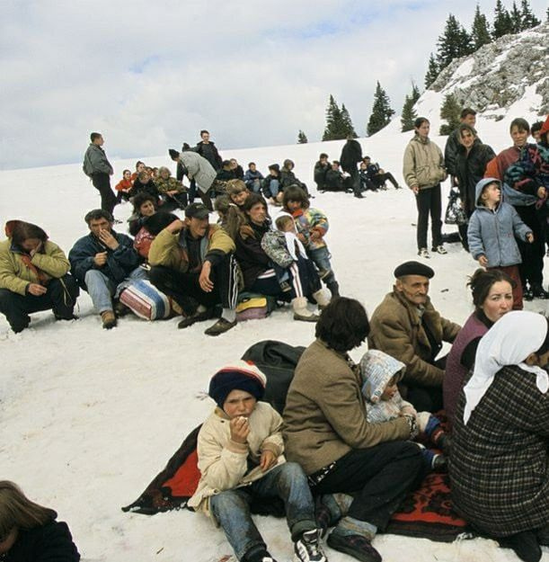
THE WAR IN KOSOVO (1998–1999)
  In the 1990s:
  Kosovo Albanians faced political repression peaceful resistance was followed by armed conflict
  the Kosovo Liberation Army (KLA) emerged
  This led to the Kosovo War (1998–1999), which caused major humanitarian crisis and destruction.
  One of the most important figures of this period is Adem Jashari, a founder of the KLA and a symbol of resistance. His death in 1998, along with his family, became a turning point in the war.
  In 1999, NATO intervened with an air campaign, which led to the end of the conflict.

Slide 4

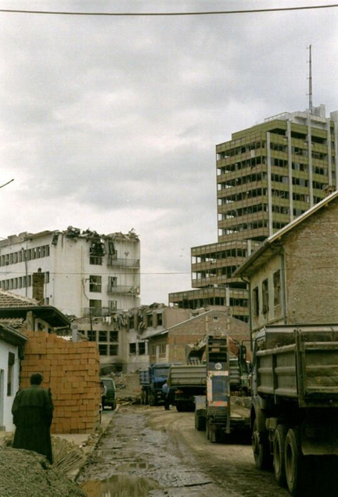
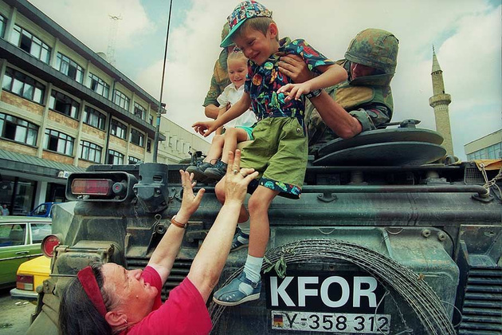
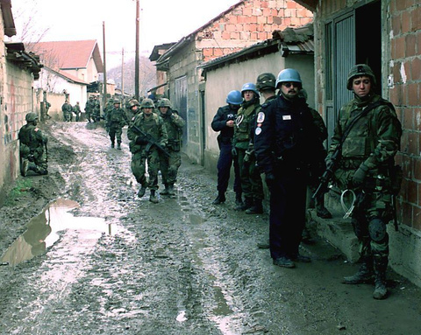
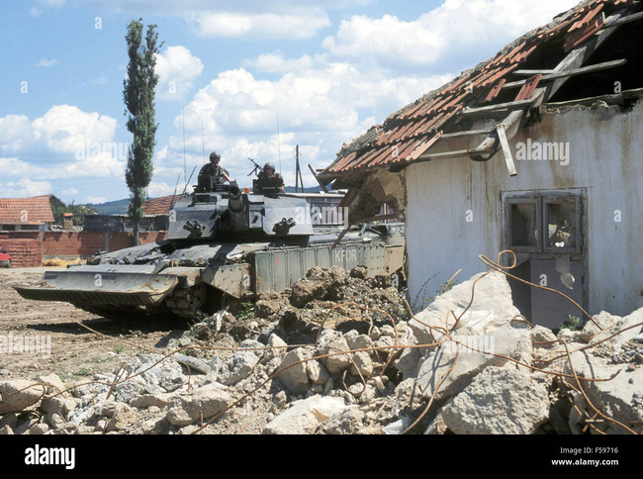
After the war, Kosovo was placed under the administration of the United Nations (UNMIK).
During this time:
  institutions were rebuilt from zero
  infrastructure was reconstructed
  education and governance systems were developed
  international organizations supported recovery
POST-WAR RECONSTRUCTION (1999–2008)

Slide 5
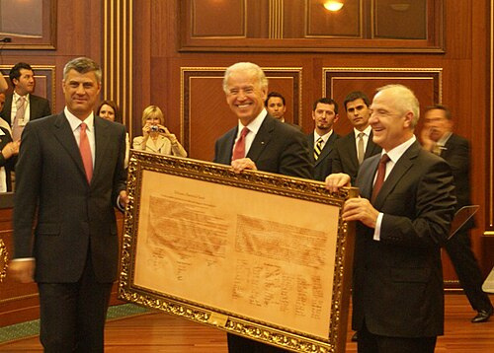

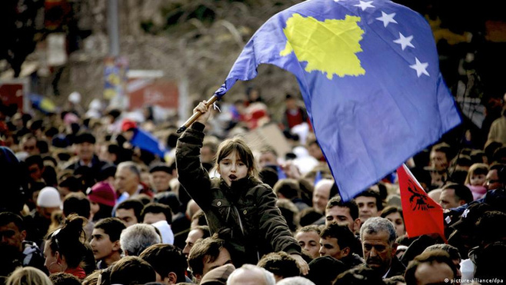
INDEPENDENCE OF KOSOVO (2008)
Kosovo declared independence on 17 February 2008.
Since then, it has been recognized by many countries and continues to develop as a young European state.
Hashim Thaçi, then Prime Minister, led the declaration, marking a key moment in state formation.
Joe Biden has been a strong international supporter of Kosovo’s independence and development.
United States president George W. Bush welcomed the declaration of independence as well as its proclamation of friendship with Serbia, stating: "We have strongly supported the Ahtisaari plan [implying Kosovo's independence].

Slide 6
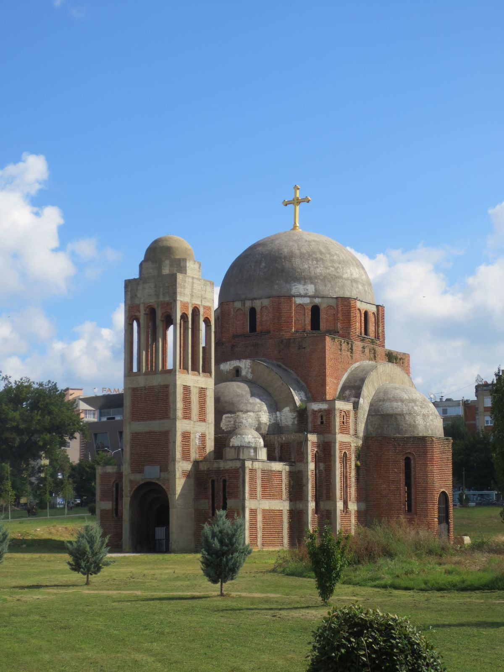

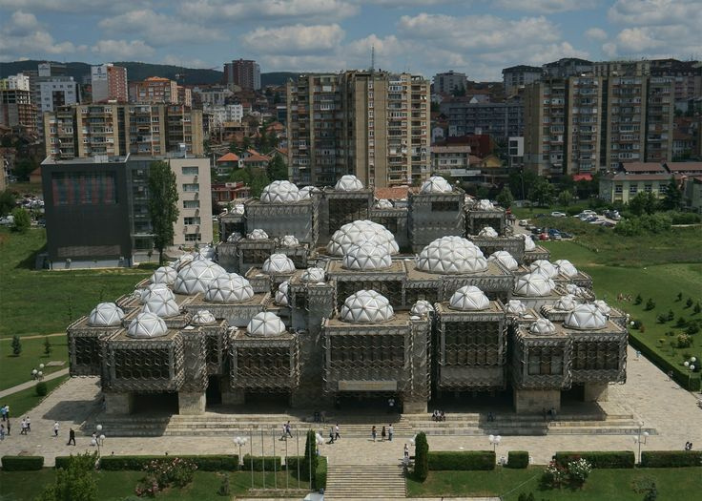
DEVELOPMENT AFTER INDEPENDENCE
After independence, Kosovo experienced rapid growth:
  reconstruction of cities
  modern architecture and urban development
  expansion of education and universities
Prishtina, the capital, has become a center of modernization and architectural change.

Slide 7
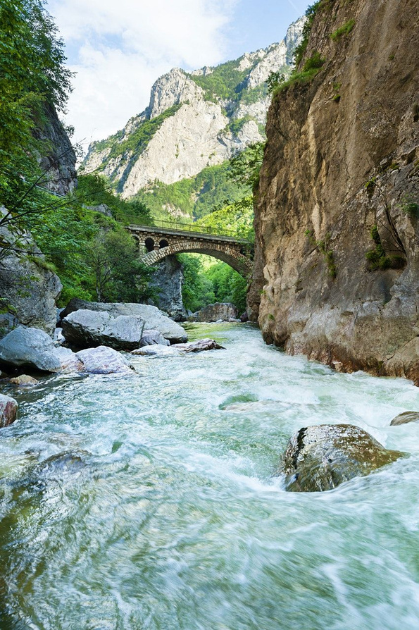
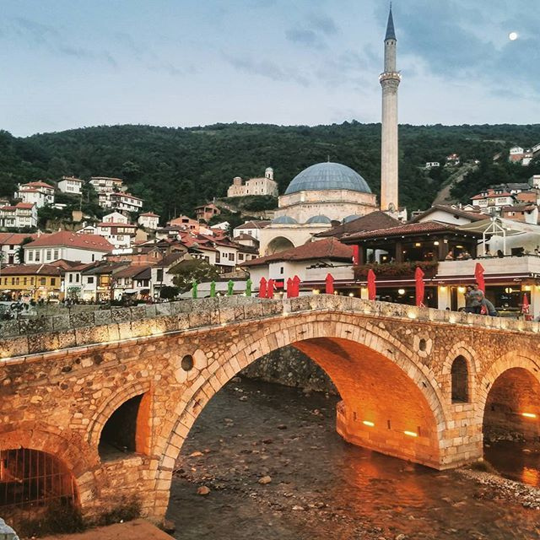
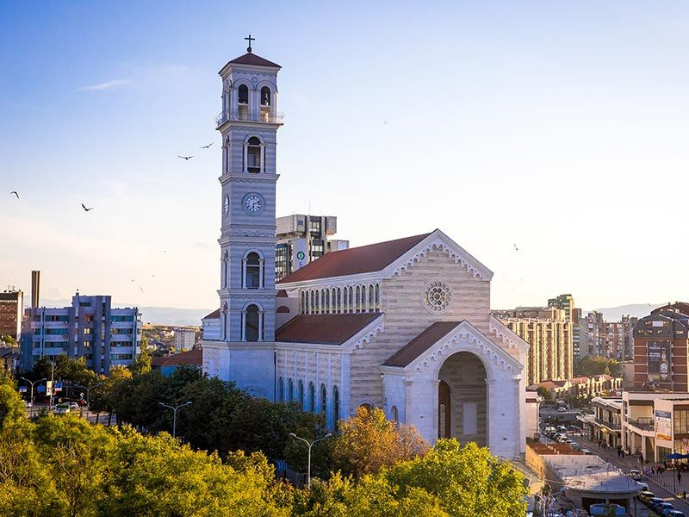
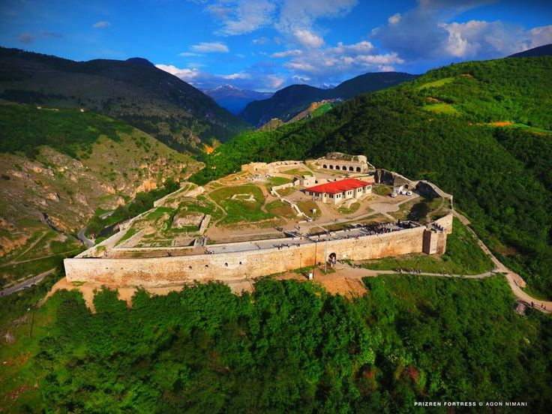
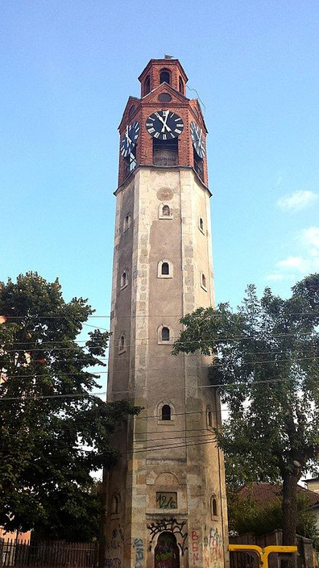
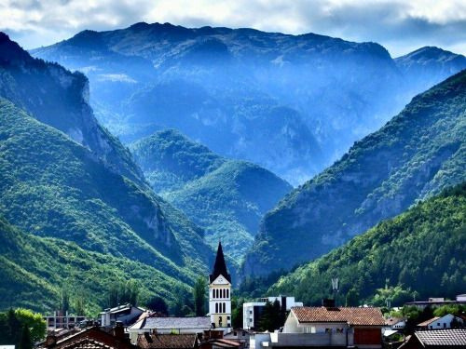
MUST-SEE PLACES
PRIZERENI
PRISHTINA
RUGOVA CANYON
PRIZEREN FORTRESS
RUGOVA MOUNTAINS
SAHAT KULLA

Slide 8
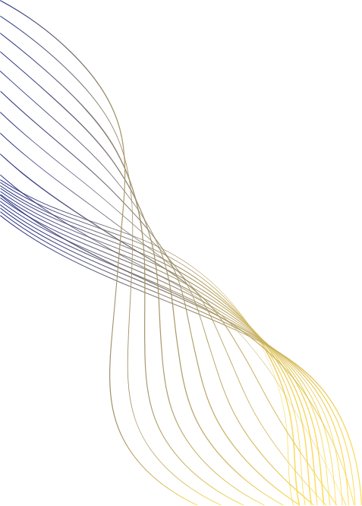

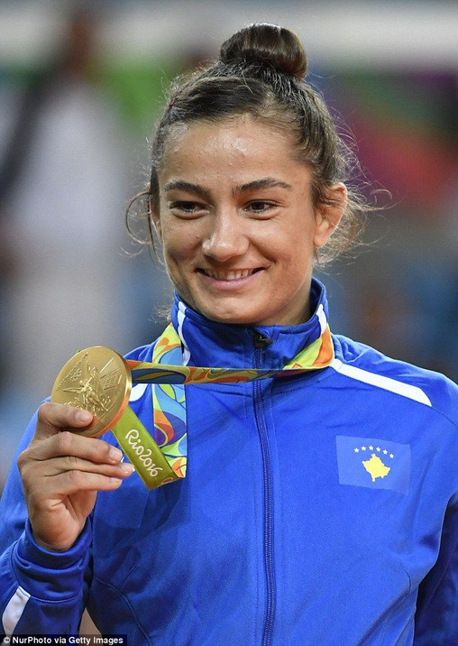


MOTHER THERESA
she is the world’s most famous symbol of humanitarianism and peace.
MAJLINDA KELMENDI
A national hero. She won Kosovo’s first-ever Olympic Gold Medal (Judo, 2016).
MIRA MARTINOVA
She was the Chief Technology Officer (CTO) of OpenAI, the company that created ChatGPT.
FAMOUS WOMEN OF KOSOVO
DUA LIPA&RITA ORA&BEBE REXHA
World-famous pop stars with Kosovar roots.

Slide 9

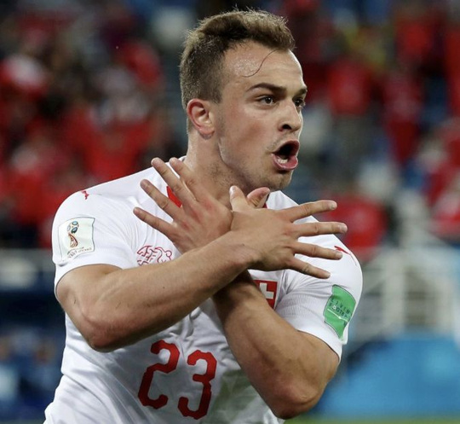

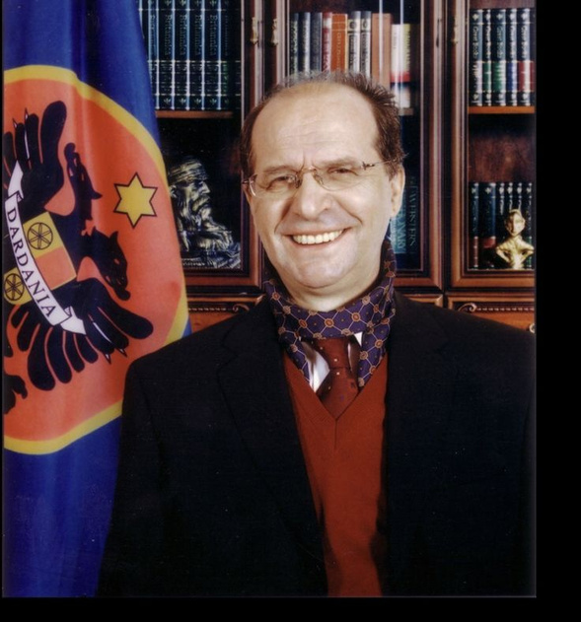


XHERDAN SHAQIRI
Famous Kosovar footballer in the world.
LORIK CANA
The most iconic captain in the history of the Albanian National Team.
IBRAHIM RUGOVA
FAMOUS MEN OF KOSOVO
Known as the "Gandhi of the Balkans." He was a literary scholar and the first President of Kosovo.
GRANIT XHAKA
Famous Kosovar footballer in the world.Played for massive clubs like Bayern Munich, Liverpool, and Arsenal.

Slide 10

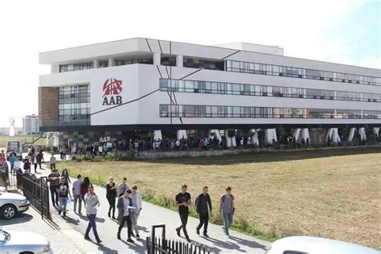
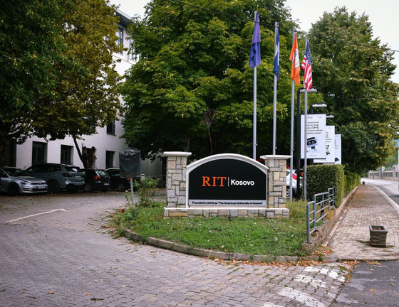
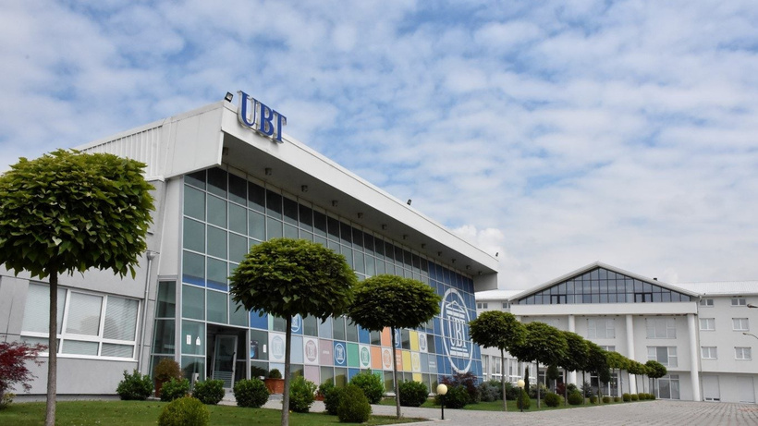
EDUCATION IN KOSOVO
  UNIVERSITY OF PRISHTINA "HASAN PRISHTINA" (UP)
The oldest and largest university (est. 1969).
  UNIVERSITY OF MITROVICA "ISA BOLETINI" (UMIB)
It is a key hub for industrial innovation, specifically in mining and metallurgy, linked to the historic Trepça complex.
  AAB COLLEGE
It has become a leader in EU integration studies, recently launching the "KO-in-EU" Center of Excellence to prepare students for Kosovo's future in the European Union.
  UBT COLLEGE
Consistently ranks high for scientific productivity and is known for its "Smart City" campus and focus on Mechatronics and Robotics.
  RIT KOSOVO (AMERICAN UNIVERSITY IN KOSOVO):
Offers an American degree from the Rochester Institute of Technology.

Slide 11


THANK YOU FOR YOUR ATTENTION

Slide 12





Criminology Analysis for Criminal Statistics: State, Democracy & Global Crime
Prof.Ass.Dr.sc.Mensut Ademi
Prof.Roberto Luis Gustavo GONZALEZ
Prof.Ass,Dr.sc.Fadil Lekaj
Abstract
This paper analyzes the interactive relationship between the state, democracy, and global crime, focusing on the criminology analysis of criminal statistics (procedural and scientific doctrinal), and their interpretation in the modern context. The paper relies on quantitative and comparative methods to examine statistical data, using indicators such as the level of crime, the typology of criminal offenses and their evolution in time and space through early warning of criminal offenses. An essential component of the analysis is the construction of a “crime map,” which reflects the geographical distribution of crime and identifies high-risk areas, linking them to socio-economic, political and institutional factors. This approach allows for a deeper understanding of the territorial dynamics of crime and helps to guide preventive policies. We also address the global dimension of crime, including phenomena such as international trafficking, cybercrime and transnational criminal networks, which transcend national borders and challenge traditional control capacities. In this context, globalization is seen as a factor that, in addition to its positive effects, has contributed to the expansion and complexity of criminal activities on a global scale. In conclusion, the importance of integrating statistical analysis with theoretical approaches in criminology is emphasized to provide a more comprehensive understanding of crime in a globalized reality. The crime map serves as a strategic tool for decision-makers and security institutions in designing effective policies for preventing and combating crime.
Keywords: Criminology, crime statistics, crime map, democracy, rule of law, organized crime, cybercrime, security policies.

Slide 13
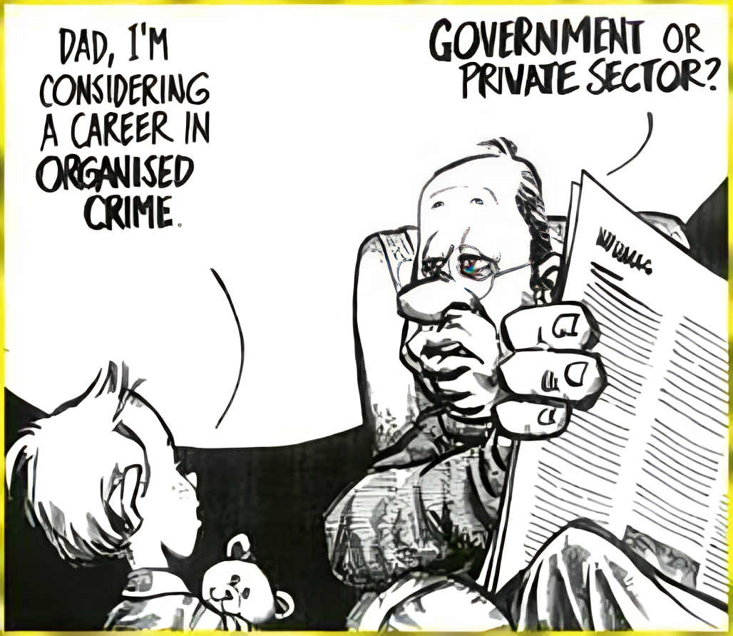

Slide 14
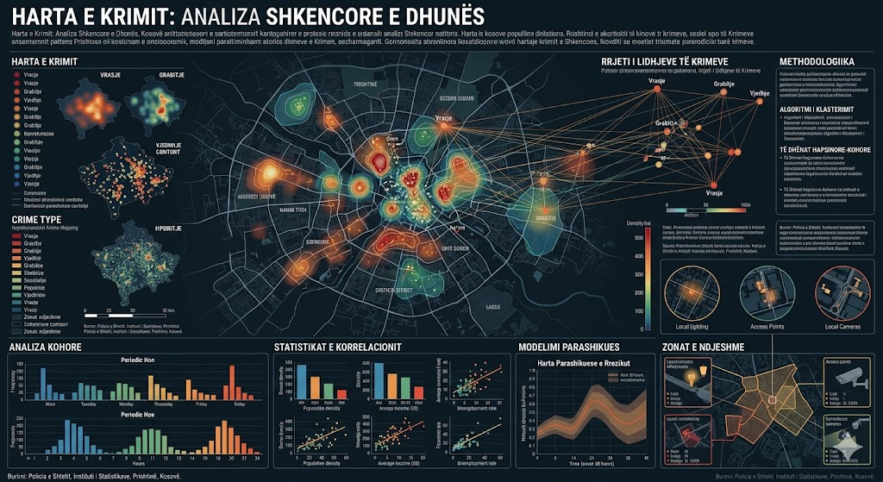
What would the criminal early warning map look like according to statistics published by institutions and statistics from scientific research?

Slide 15
Early Warning Through Scientific Doctrinal Methods
Criminality Prevention
Fighting crime
Rehabilitation and resocialization of victims
Which academic scientific projects would be in focus to come up with preventive measures
ISRD Juvenile Delinquency / Fear of SVV Criminality FF / Domestic Violence DV / Extremism and Radicalism ER/ Rehabilitation and Resocialization RR
0-18 years old -ISRD,SVV,DV
18-35- SVV, FF, DV,ER, RR
35-65- FK, FF, DV,RR
65- 99- FK,FF, ER, DV, RR
2004 2016 ???
The percentage of perpetrators of criminal offenses is between the ages of 24 and 32, around 60%. We need to analyze what happened in 2016 and 2024 when these were minors.

Slide 16
Organized crime activities in the Western Balkans
1. Human trafficking
2. Narcotics smuggling
3. Arms trafficking
4. Migrant Smuggling
6. Cyber Crime
7. Money laundering
8. Corruption
9. Prostitution
10. Gambling
11. Fuel Smuggling
12. Cigarette Smuggling
13. Falsification of EU employment documents
Note:
We must always be careful with stereotypes because labeling harms research. We must always have scientific methodology with data.

Slide 17
Criminality And Registered Criminality
Registered
(Policia)
Accused (Prosecution)
Tried (Court)
Serving sentence (SC)
Process procedure Operational Process Police, investigatory and judicial/ INVESTIGATION
Early warning issues Academic scientific research approach/ RESEARCH
To be successful in combating and preventing crime through crime maps as an early warning, INSTITUTIONAL data and statistics must be transparent and published (Case WBC, Kosovo published every year https://ask.rks-gov.net/)

Slide 18
Purpose –
Therefore, the basic purpose of dealing with this topic is to detect and identify new forms of this criminal phenomenon by minors as perpetrators of criminal offenses, to explain the causes of their occurrence and to propose measures to prevent and combat them, thereby enabling law enforcement agencies and institutions to have a model of early warning of the forms of these deviant behaviors.
2030
age 20 years (adult minor)
Full criminal liability
2031
age 21 years (adult)
Full criminal responsibility
2032
age 22 years
2033
age 23/24 years
2004 2016 ???
The percentage of perpetrators of criminal offenses is between the ages of 24 and 32, around 60%. We need to analyze what happened in 2016 and 2024 when these were minors.
2024 age 14 years
2025 15 years
2026 age 16 years
2009
Mosha 17 Vjet
2010
Mosha 18 Vjet
2011
Mosha 19 Vjet

Slide 19
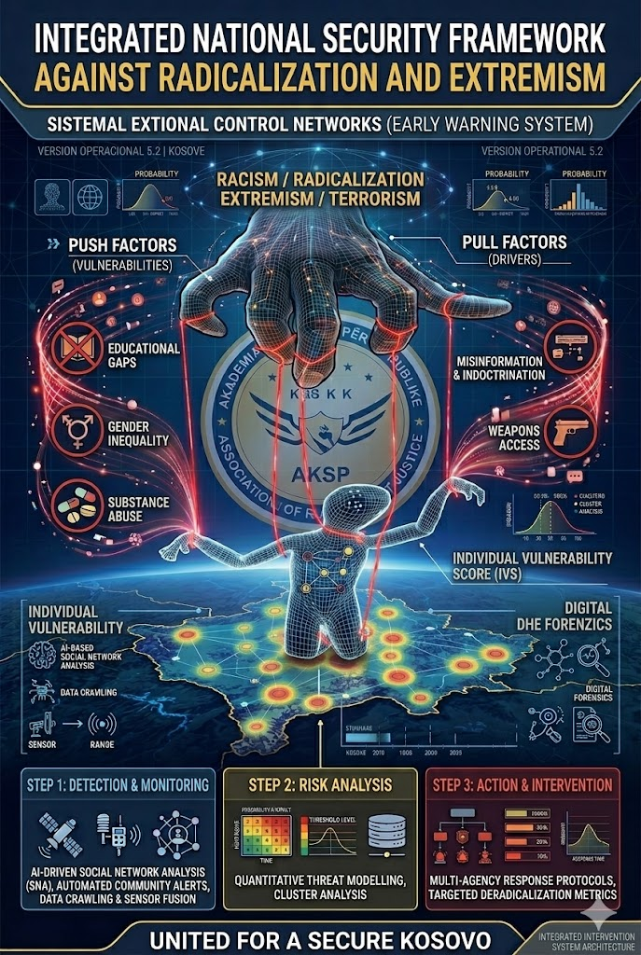

Slide 20
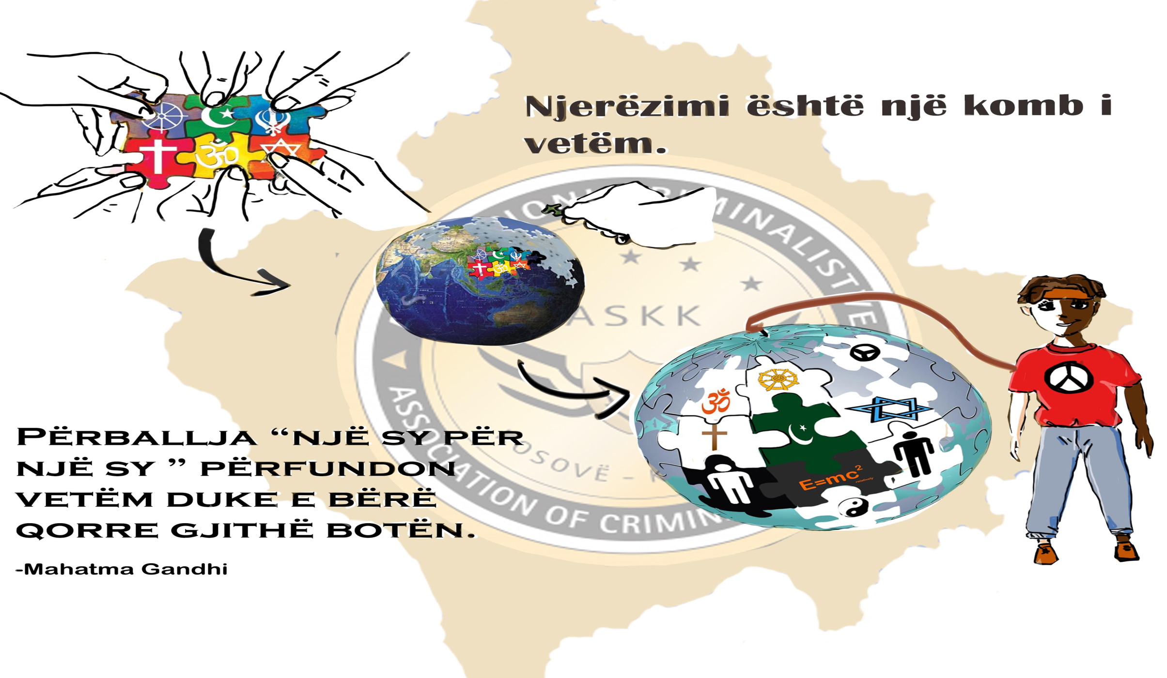
Humanity is one nation
An eye for an eye only ends up making the world blind.

Slide 21
Theories of criminal causes
How can we know and take action according to theories about early warning?
Choice theory
The theory of fear
Control theory
Morale-raising theory
Social response and labeling theory
Cultural conflict theory

Slide 22
Topic
ISRD
Victimization Study
Selfreport and viktimisation report
Volume and structure of crime.
Social mobility and crime
Temporal and seasonal characteristics of crime
Etiology and phenomenology of situations

Slide 23
The brilliant work of security institutions and their data through MODUS Operandi, Ante, Tempore, Post Reconstruction ATPR, POS Police operation system, etc. give us in science the opportunity to use RESEARCH methods around early warning according to:
Seasons as a source of crime and opportunities for criminal activity
Winter
Light 07::-16:00
T+5c deri -12c
Spring
Light 06:00-18:00
T +20 deri -2
Summer
Light 04:30-21:00
T +20 deri +40
Autumn
Light 06:40-17:00
T +15 deri -5

Slide 24
Criminality And Registered Criminality
We need to know and distinguish the working methods and know exactly what authorizations are:
Early warning issues Academic scientific research approach/ RESEARCH
Universities, Institutes, Academies, Professors, P.h.D. etc.
Process procedure Operational Process Police, investigatory and judicial/ INVESTIGATION
Police, Prosecutor's Office, Court, Security services, Army, etc.
To be successful, all entities must cooperate according to the methodologies provided for in the Code, Law, Strategy, Program, etc.

Slide 25
Early warning issues Academic scientific research approach/ RESEARCH
Social economic factors
Unemployment
Poverty
Economic crises
Migration
Emigration
Causes of family nature
Conflicts in the family
Domestic violence
Sexual abuse in the family
Divorce and other anomalies
The Impact of Mass Media Factors
Television
Internet, social networks
The impact of school and the juvenile education system
Violence in schools
Free time and socializing with peers
Criminal offenses against property
Criminal offenses of abuse of narcotic substances
Criminal offenses against sexual integrity.
Criminal offenses against life and body.
Criminal offenses against public order and security.
2004-2016
1-6 ??
It has been found that the main factor in the presentation of juvenile delinquency in the reporting period is family, society, economic conditions, culture, social networks, education, and personality of minors, while the motives are sufficient mental immaturity, not emotional stability, social circle, sexual motive and socio-economic situation

Slide 26
Early warning Crime Maping
Criminal Topography
  Learning about the place where the crime was committed
Criminal geography
  Studies the types of criminal offenses that occur in public places;
  It studies the flow/exit of people prone to criminal behavior in a space ("the mobility of criminals")
Crime Map
  Ability to geocode the location of a specific crime on a map for analysis

Slide 27
Techniques for using GIS
Data Creation 1/6
Linking information from different sources
Data Presentation POS and Research
Data Collection POS and Research
Examinations, coordination systems and registration
Spatial Analysis in GIS
Hartography/ Preventive

Slide 28
Application of GIS
Through scientific research and analyzed data, we help institutions take timely preventive measures, Digitized maps with data containing geographic or location components:
  Location/Location of Criminal Activity
  Residential addresses of criminal groups
  Geographical Jurisdictions of Police Stations
  The residential addresses of the suspects (street, number...)
  Names of counties, states, zip codes, etc.
  Information on criminal offenses
Geocoded information with different symbols

Slide 29
Importance of GIS
Crime Monitoring
Crime Control
Crime analysis
Crime Investigation
Criminal networks
ect

Slide 30
Regional Approach
Country- R.Kosovo, Albania, R.V.Macedonia, BiH, Croatia, Slovenia, Bulgaria, Romania, Hungary, Turkey, Greece, Serbia
-Identification of common problems in:
Albania, FYR Macedonia, BiH, Croatia, Slovenia, Bulgaria, Romania, Hungary, Turkey, Greece, Serbia
Through this research we will be able to identify all criminal offenses according to implementable international projects in the Western Balkans
Activities: Workshops, Conferences, Scientific papers and publications, lectures, Research!
All these activities will be implemented through joint scientific memberships of countries in the region such as in Universities, Associations, Institutes supported by the EU and the USA according to contemporary methodologies. Through this research we will achieve:
Inform ourselves and accurately inform ourselves about the issues, Plan national strategies for our country, Conduct discussions for the benefit of our country, Recommend and propose recommendations for our country, Take positions and recommend that they take positions, Cooperate and offer cooperation for joint preventive actions, Implement programs for our country.
All of these are achieved through Professors with degrees, Students, Scientists with degrees, Other persons with degrees from each country in the Western Balkans region

Slide 31
Transatlantic drug trade
EUROPE,WBC, LATIN AMERICA AND THE NEED TO STRENGTHEN ANTI-NARCOTICS COOPERATION
Main trafficking routes (Latin America → Europe)
According to data from the EU Drugs Agency (EUDA):
Drugs (especially cocaine) are mainly produced in Colombia, Peru and Bolivia
Transported to Europe:
by ship (main route)
by plane (individual courier)
The main entry points into the EU are:
Spain
The Netherlands
Belgium
France and Italy
Western Ballkan
➡️ Around 91 tonnes of cocaine are consumed each year in Europe, while the market is estimated at around 5.7 billion euros
The role of Balkan organized crime
Research and police operations show that:
Criminal groups from the Balkans cooperate with Latin American cartels
They often:
organize the initial transport
control the distribution in Europe
A joint international operation revealed:
a “Balkan cartel” trafficking cocaine from Latin America to Europe
8 tons of drugs were seized and 40 people were arrested
According to reports from the EU Drugs Agency (EUDA) and Europol, cocaine trafficking from Latin America to Europe is carried out mainly via sea routes and containers, with departure points such as Brazil, Colombia and Ecuador. The Balkans play an important role as a transit and distribution area, while Balkan criminal groups cooperate with Latin American networks in this global supply chain.

Slide 32
Trafficking methods
Infiltration of logistical supply chains
Intermodal shipping containers
Container switching, code fraud, extraction teams
Corruption, intimidation of officials and vessel operators
More use of smaller ports
Floating GPS-tagged drops
Collection from mother ships by small vessels
Speedboats, pleasure craft
Semi-submersibles (narco subs, torpedoes)
Chemical concealment or masking of shipments
More use of general aviation, small airfields

Slide 33


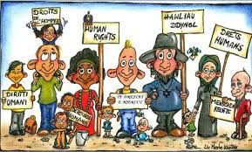
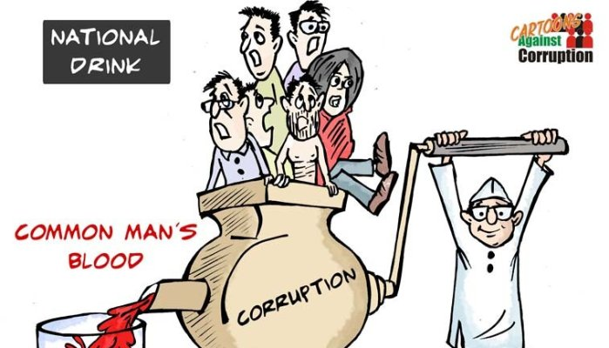
Volume and structure of crime
Vëllimi dhe struktura e kriminalitetit
Social mobility and crime
Mobiliteti shoqerorekr dhe kriminaliteti
Time and seasonal characteristics
Veçorit kohore dhe sezonale
Regional characteristics
Veçorit regjionale
Spread of crime Village city
Perhapja e kriminalitetit Fshat qytet
Mosha, Gjinija dhe kriminaliteti
Gjendja martesore dhe statusi familjare
Gjendja sociale
KUPTIMI I FENOMENOLOGJISE KRIMINALE

Slide 34

To access crime data we need scientific approaches and methodologies as well as the need for real-time surveillance to detect threats early and protect communities more effectively.

Slide 35

THINK -BIG
START
SMALL
LEARN
FAST

Slide 36
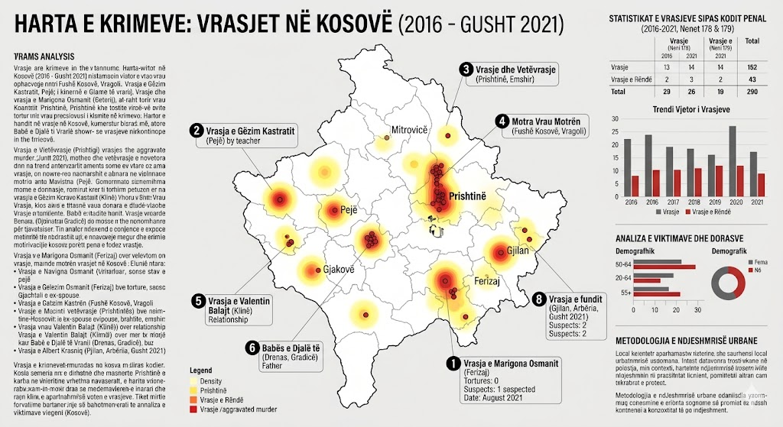
Map of murders by region

Slide 37
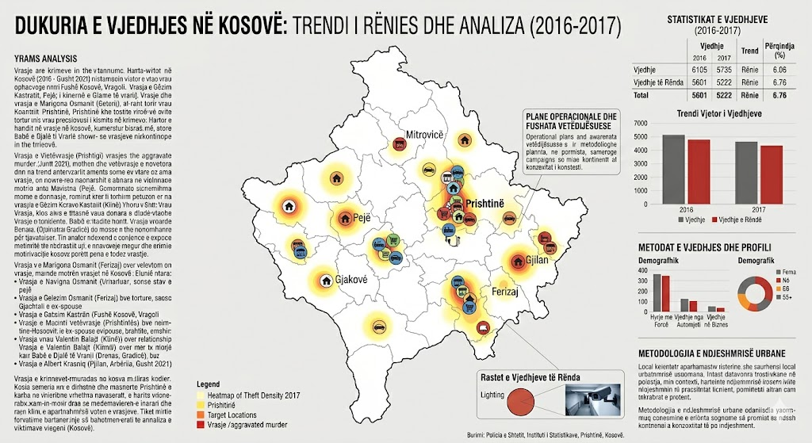
Map of predatory robbery in Kosovo

Slide 38
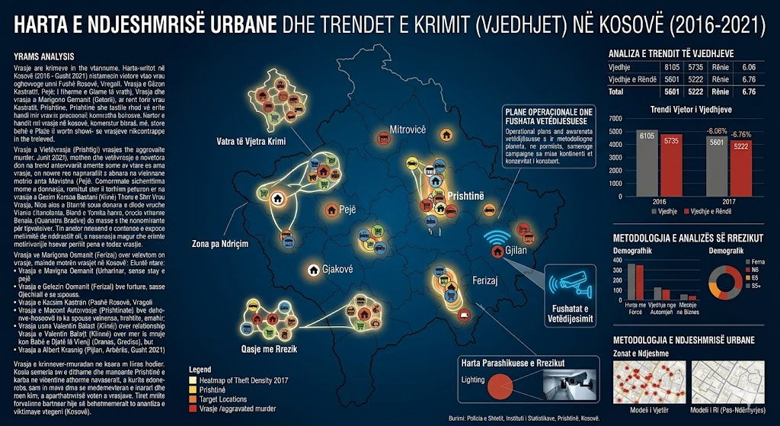
Map of predatory robbery in Kosovo

Slide 39
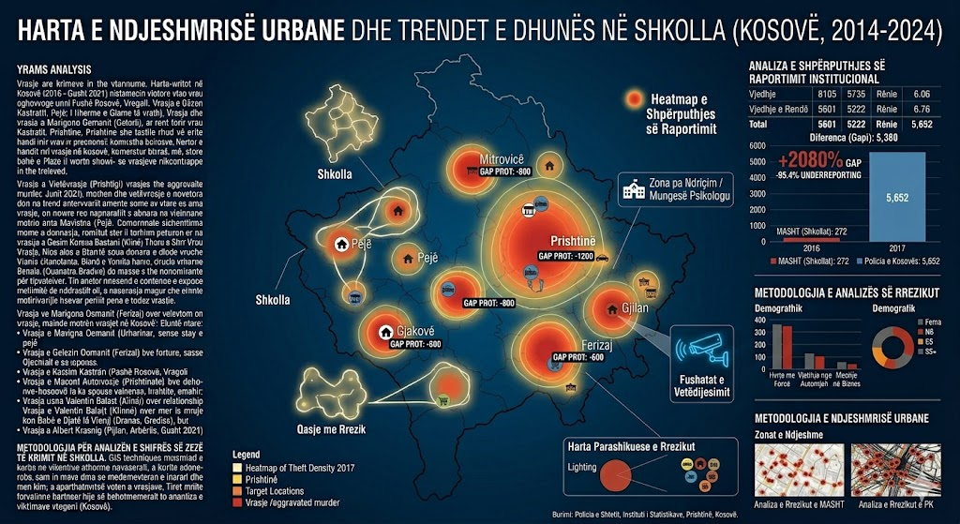
Violence in schools

Slide 40
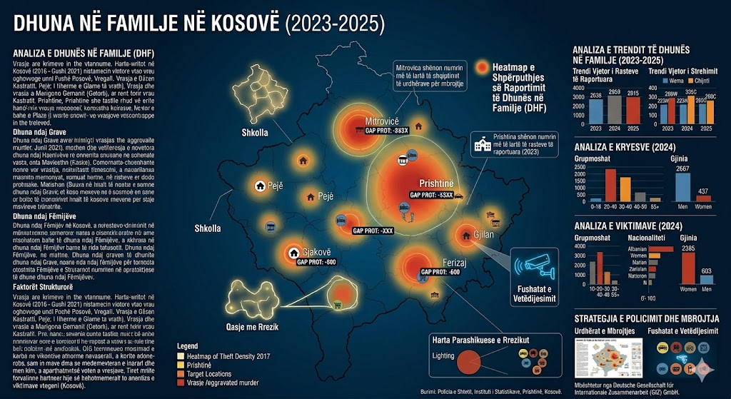
Domestic violence

Slide 41
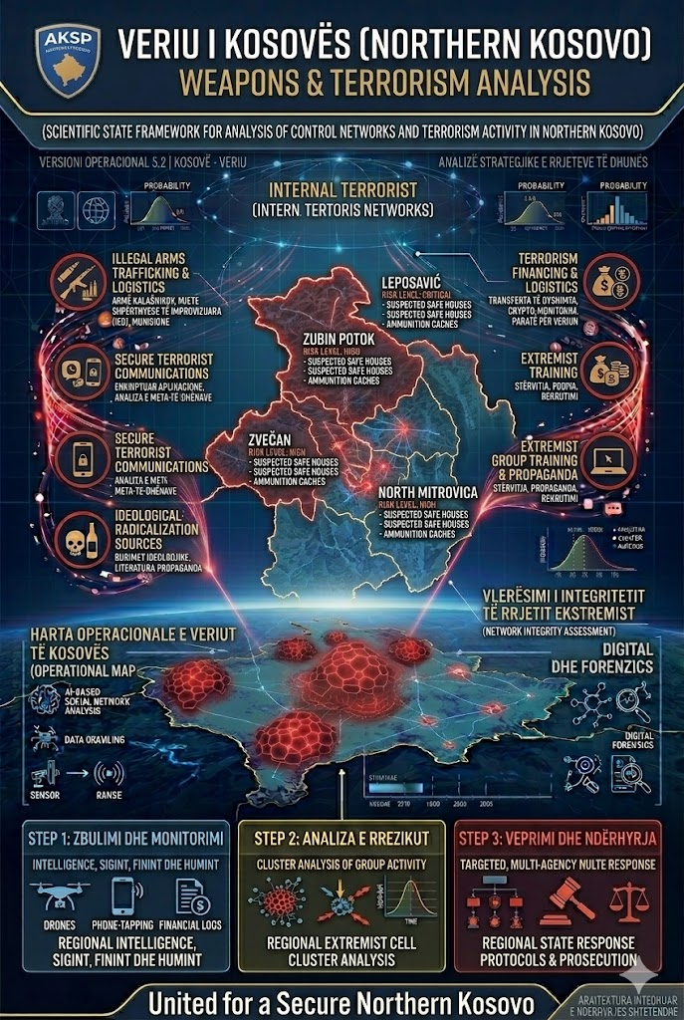

Slide 42
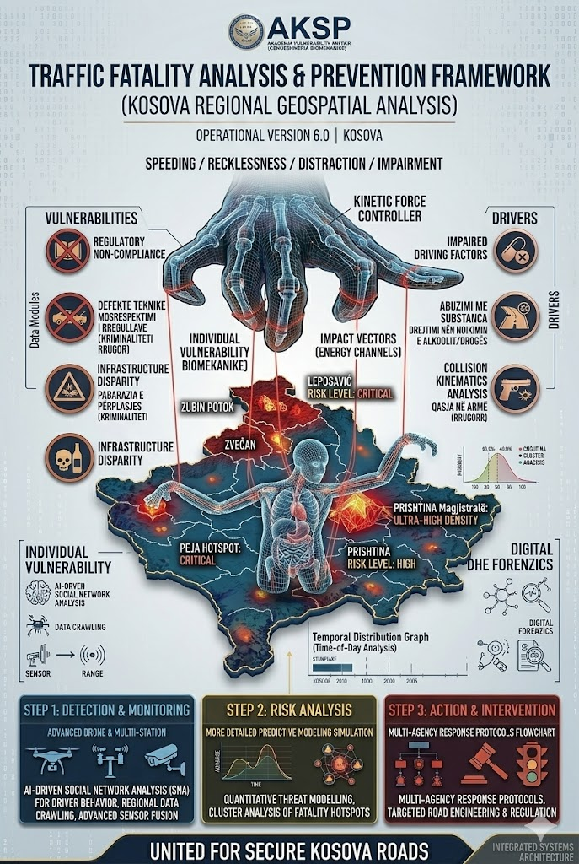

Slide 43
Overview
Crime as a complex and dynamic phenomenon represents one of the greatest challenges for the state and contemporary society. Within Criminology, the analysis of crime statistics and their interpretation constitute the basis for understanding the causes, forms, and development of crime at the national and global levels. The interaction between the state, democracy and crime is essential for assessing the effectiveness of security institutions and policies. Recent global developments, including the growth of cybercrime and transnational criminal networks, have increased the need for more advanced analytical and statistical approaches, as well as for the use of tools such as crime maps and early warning systems. The main purpose of this paper is: To analyze the relationship between the state, democracy and global crime, To assess the role of crime statistics in identifying and predicting crime, To demonstrate the importance of crime mapping as an analytical and strategic tool, To contribute to the improvement of security policies through scientific analysis.

Slide 44
Methodology
The paper is based on a combined methodological approach:
a) Quantitative method - statistical analysis of crime data;
b) Comparative method - comparison between countries and regions;
c) Criminological analysis - theoretical interpretation of criminal phenomena;
d) Analytical approach (SPSS/GIS style) - data processing and spatial representation of crime.
Data sources: 2004-2015 ??
a) Law enforcement institutions,
b) International reports,
c) Scientific studies,
Hypotheses
The paper raises the following main hypotheses:
H1: There is a direct relationship between the level of democracy and the reduction of crime.
H2: Unemployment and socio-economic factors significantly affect the increase in crime.
H3: Cybercrime is constantly increasing as a result of globalization and technological development.
H4: The use of statistical analysis and crime maps increases the efficiency of crime prevention.

Slide 45
Research questions
This study aims to answer the following questions:
Q1: How does the level of democracy affect the crime rate?
Q2: What are the main trends in crime at the global level?
Q3: How can crime statistics be used for early warning?
Q4: What is the role of crime maps in identifying high-risk areas?
Q5: How does globalization affect the transformation of forms of crime?
Study Issues
The main issues of this paper lie in:
P1: The lack of integrated analyses between criminal statistics and criminological theory
P2: Limitations in the quality and harmonization of statistical data between countries
P3: The growth of new forms of crime, especially cybercrime
P4: Institutional weaknesses and challenges in the rule of law in some countries
P5: The need for more efficient early warning and predictive analysis systems

Slide 46
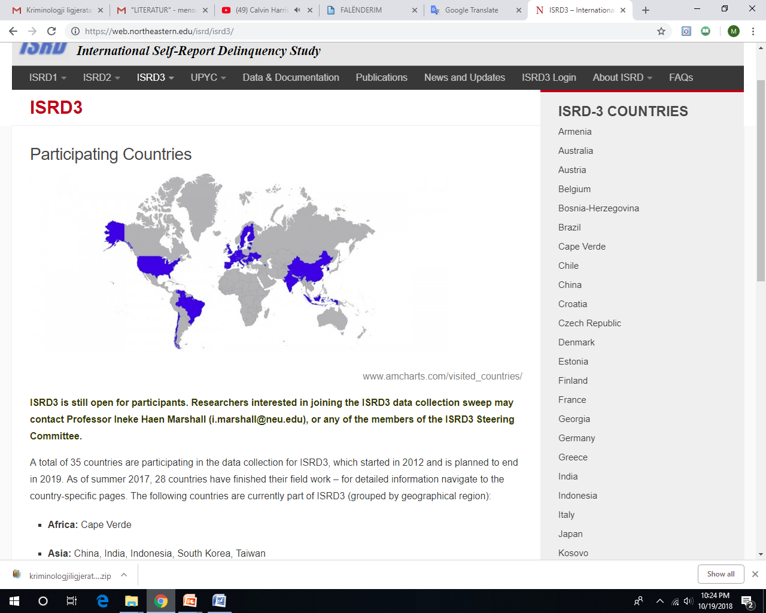

Slide 47
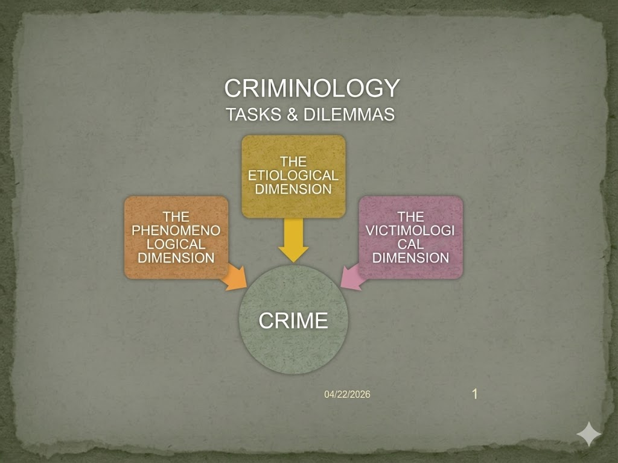

Slide 49
"Throughout scientific theories and methodologies, our greatest global challenge remains to stay ahead of others in providing actionable support for the implementation of the ROOL OF LAW. Academies and Universities must come together through academic and scientific data to empower our institutions. If we do not educate our generations based on our values ​​and culture, others will step in to educate them for their own radical and extremist interests."
"EDUCATE TO PROTECT: If we don't shape the future of our youth through our culture, extremists will."

Slide 50
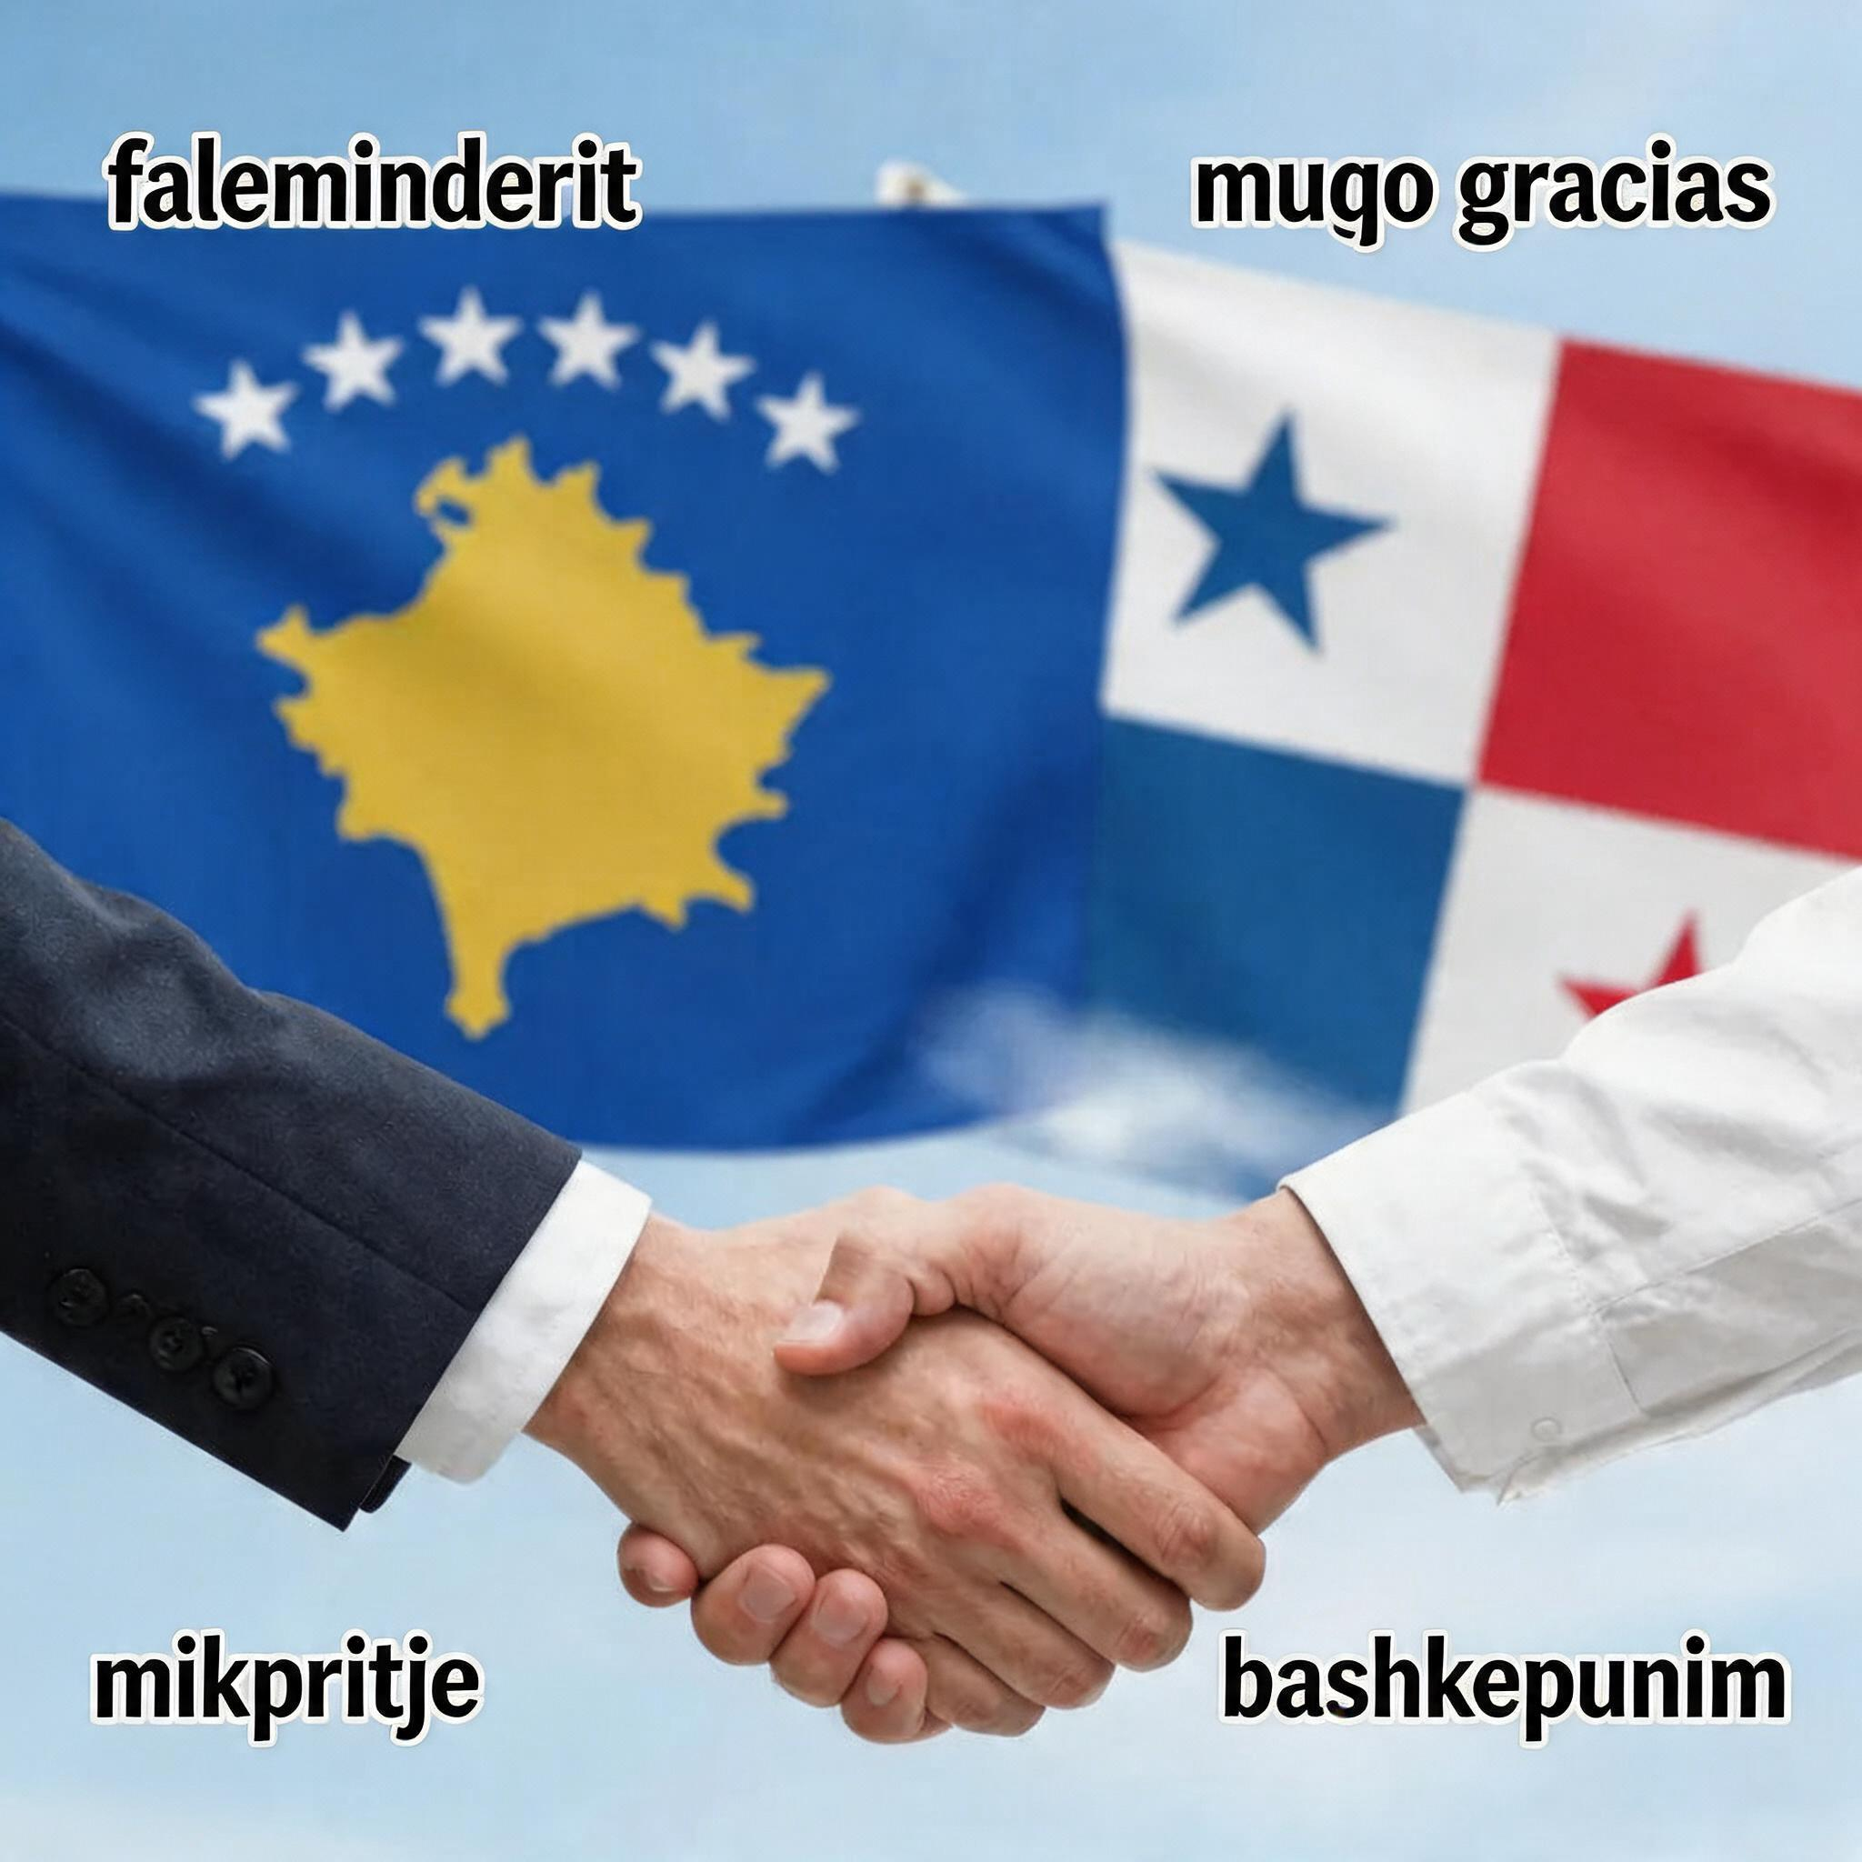
I thank you for the academic and scientific cooperation and I am very happy that I will introduce and elaborate with many details about life, hospitality, and academia in Latin American countries, especially in PANAMA, to students from the Western Balkans. You are very good friends.
THANK YOU FOR YOUR PATIENCE DURING THE ELABORATION AND YOUR QUESTIONS.

